Slide 1
Computer Vision
Turn image into data

Slide 2
What is Computer Vision?
Endow machines with the ability to
make sense of the physical world by
looking at measurements of reflected light
Let computer “understand” what they see

Slide 3
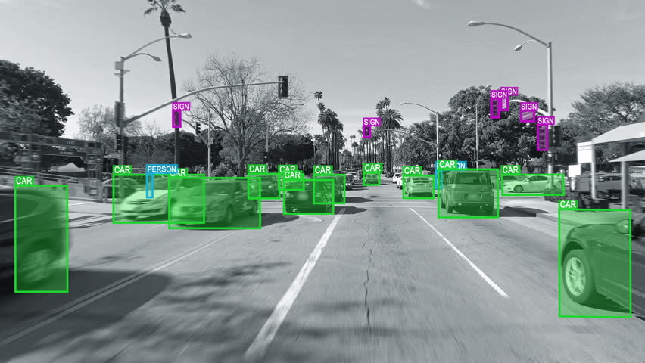
Examples of computer vision self-driving cars

Slide 4
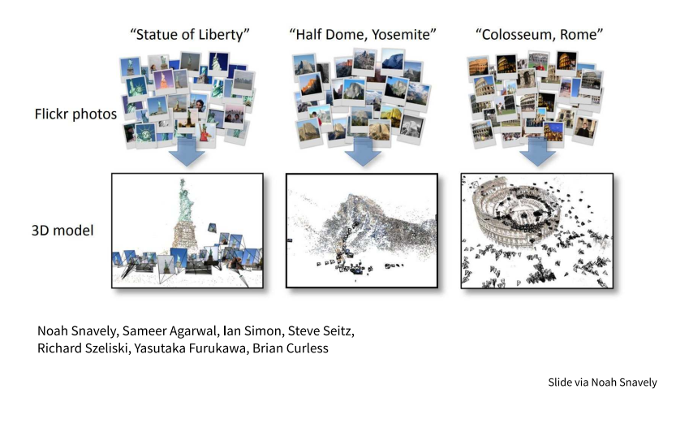
Examples of computer vision “building Rome in a day”

Slide 5
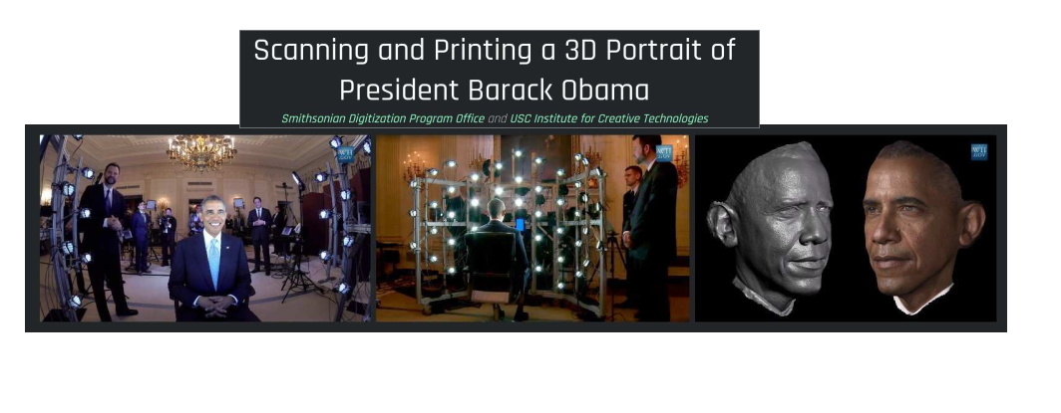
Examples of computer vision

Slide 6
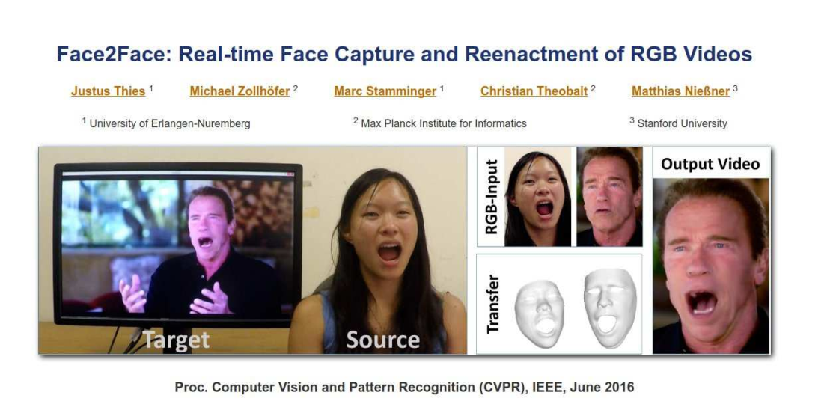
Examples of computer vision
Notes:
In the past, when shooting sci=fi films

Slide 7
Texture synthesis

Slide 8
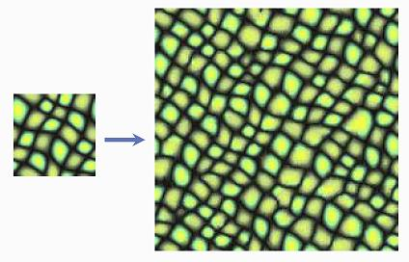
Texture synthesis

Slide 9
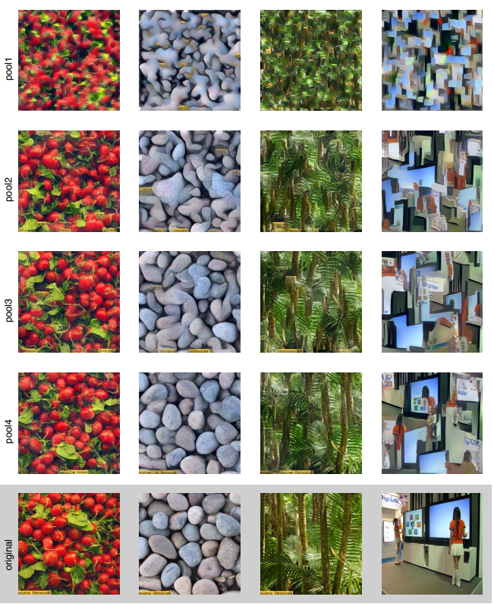
Neural network is the solution to every problem, including texture synthesis

Slide 10
Neural network is the solution to every problem, including texture synthesis
VGG Network
(trained on object recognition)
Feature map 1
Loss function:
difference between 1 and 2
Noisy image
Feature map 2
Back-prop
Back-prop

Slide 11
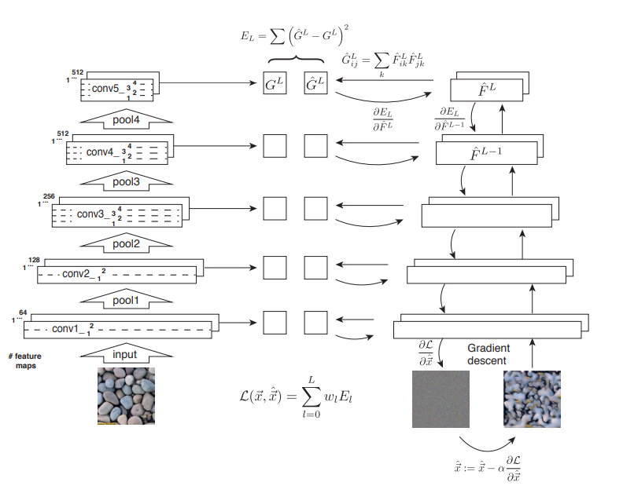

Slide 12
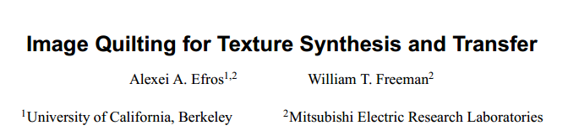
However, there exists simpler & more efficient solutions to texture synthesis.
2001: “The algorithm is not only trivial to implement but is also quite fast: the unoptimized MATLAB code used to generate these results ran for between 15 seconds and several minutes per image depending on the sizes of the input and output and the block size used.”

Slide 13
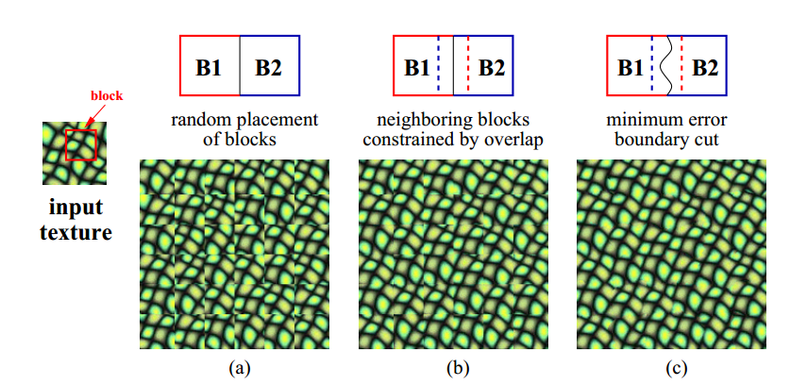
Image quilting for texture synthesis

Slide 14
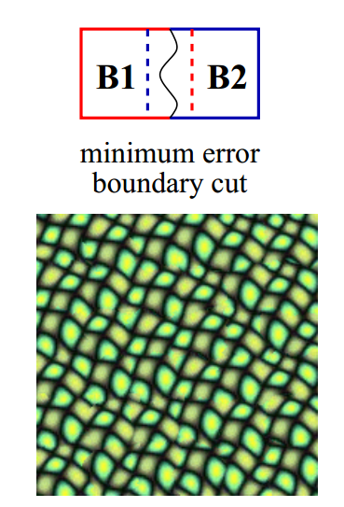
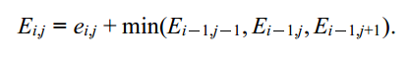
Dynamic programming

Slide 15
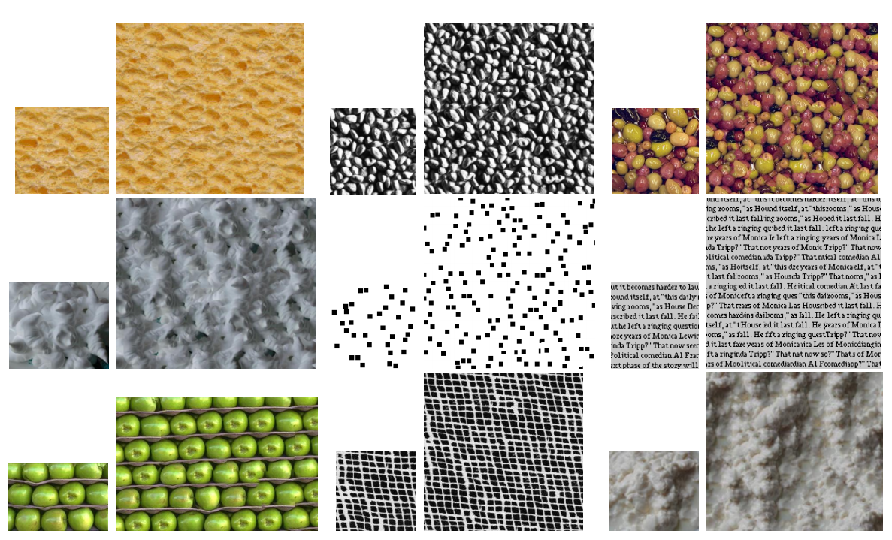
Image quilting for texture synthesis

Slide 16
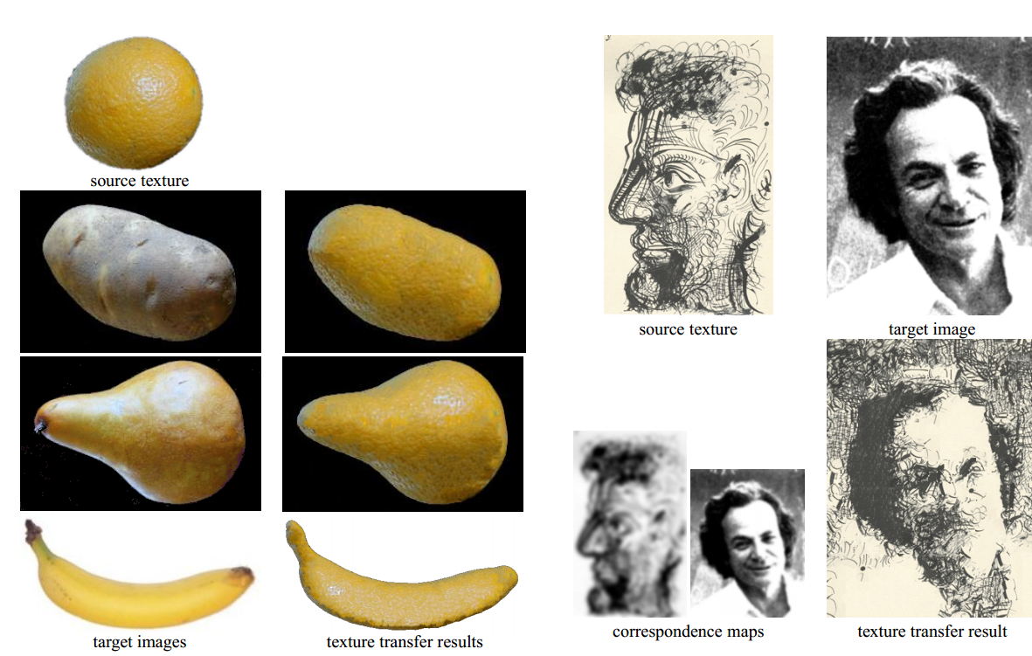
Image quilting for texture transfer

Slide 17
Take home messages
Computer vision is more than just Convolutional neural networks (CNN)
Solving the problem by CNN can give us hints about human brain (what is texture?)

Slide 18
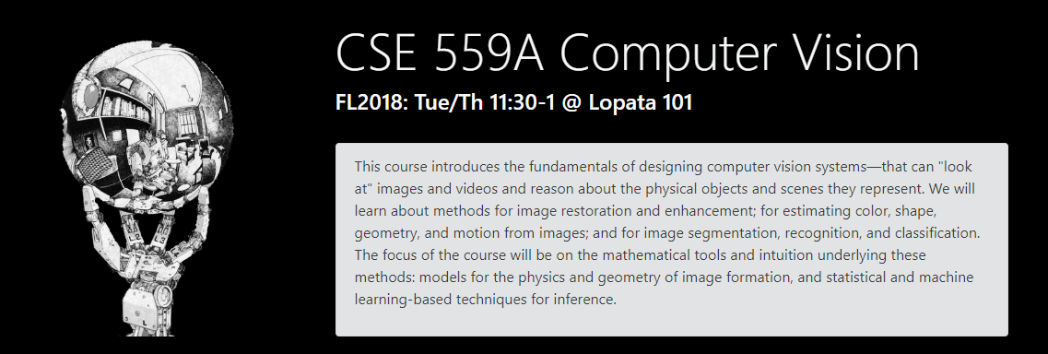
Thanks!

